Slide 1
Binding and Closure in JavaScript
Presented by :Randa Hammam

Slide 2
Binding
.
Binding : JavaScript binding is the process of determining what this refers to in a given execution context. It also involves the association of functions and variables within a particular context or scope. There are two main types of binding in JavaScript,How JavaScript binds the context of this to functions
Binding in Classic JavaScript:
1. Implicit Binding :
- `this` refers to the object calling the method.
Occurs when an object is used to call a function, and the context (this) is automatically bound to that object.
2. Explicit Binding (call(), apply(), bind()): - `this` You can explicitly set this using functions like call(), apply(),bind()
Default Binding: - `this` falls back to the global object.

Slide 3
Definition of this in JavaScript:
.
In JavaScript, this refers to the execution context of the function in which it is used. It represents the object that is currently executing the code. The value of this is determined by how a function is invoked, not by where it is defined. It can refer to different objects depending on the context:
Global context: Refers to the global object (window in browsers).
console.log(this); // In the browser, it will log the Window object.
Method context: Refers to the object that is invoking the method.
const obj = {
name: 'Alice',
greet: function() {
console.log (this.name); // 'this' refers to obj
}
};
obj.greet(); // Output: Alice

Slide 4
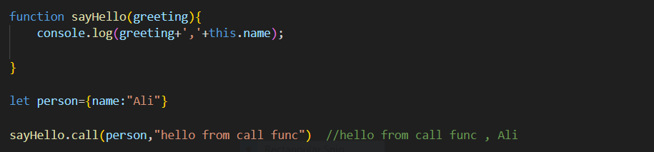
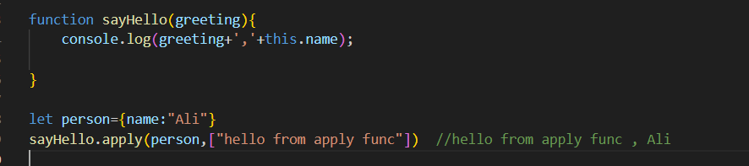
What is the difference between bind(), call(), and apply()?
.
.
call(): Immediately invokes the function with a specified this value and arguments passed individually.
apply(): Similar to call(), but arguments are passed as an array.

Slide 5
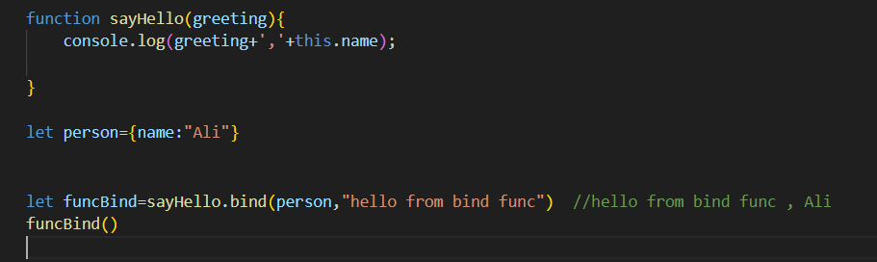
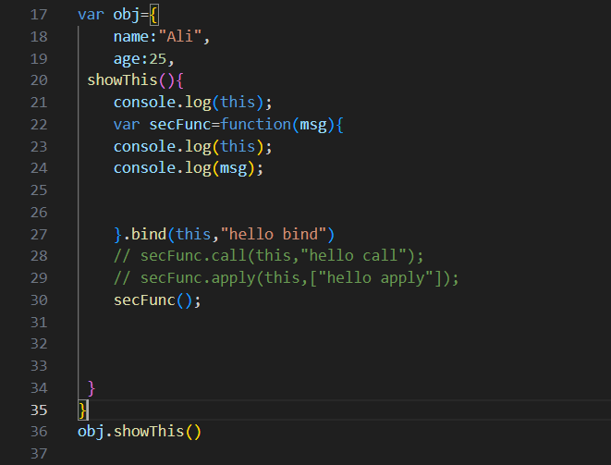
bind(): Returns a new function with the specified this value, but does not immediately invoke it
With use bind,call,apply

Slide 6
Constructor context: Refers to the new object being created by a constructor function.
function Person( _name ) {
this.name = _name;
}
const person1 = new Person('Bob');
console.log(person1.name); // Output: Bob
Arrow functions: this is lexically bound..do not have their own this context. Instead, they inherit this from the surrounding (lexical) context in which they are defined.
const obj = {
name: 'David',
greet: () => {
console.log(this.name); // 'this' is lexically bound, likely to the global object
}
};
obj.greet(); // Output: undefined (in strict mode)

Slide 7
Classic JavaScript: Advantages and Disadvantages
Advantages:
- Flexibility: Allows dynamic binding.
- Reusability: Functions can be reused.
Disadvantages:
- Complexity in managing `this`. - Overuse of .bind().

Slide 8
Binding in Modern JavaScript (ES6+)
1. Arrow Functions:
- `this` is lexically scoped to where the function is defined.
Modern JavaScript: Advantages and Disadvantages
Advantages:
- Simpler context management with arrow functions.
- Cleaner code, less need for .bind().
Disadvantages: - No dynamic `this`. - Arrow functions are not always suitable

Slide 9
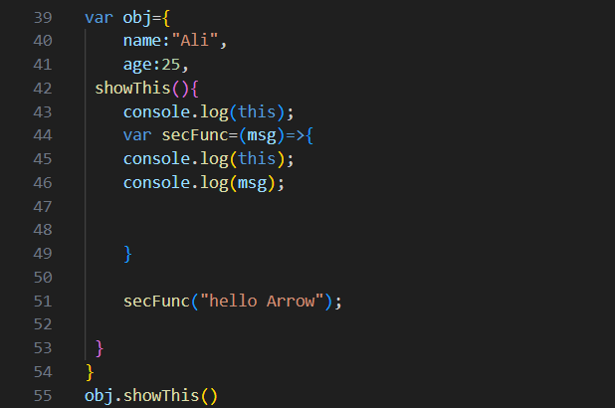
With Arrow Functions:

Slide 10
Closure
A closure is a fundamental concept in JavaScript where a function retains access to variables from its lexical scope (the environment in which it was created), even after that outer function has finished executing. This allows the function to "remember" the environment in which it was created.
How Closures Work:
When a function is defined inside another function, it forms a closure. The inner function has access to:
Its own variables.
The variables of the outer (enclosing) function.
The global variables.
Even when the outer function has completed execution and its variables would normally be destroyed, the inner function retains access to those variables through the closure.

Slide 11
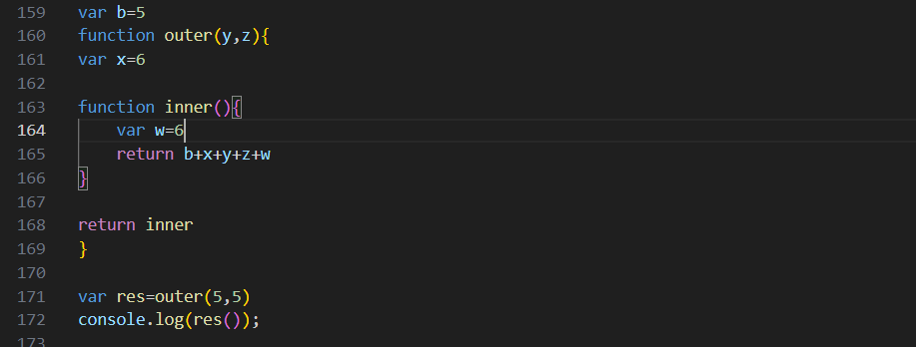
function outerFunction() {
let outerVariable = 'I am outside!';
function innerFunction() {
console.log(outerVariable); // Accessing the outer variable
}
return innerFunction;
}
const closureFunc = outerFunction();
closureFunc(); // Output: 'I am outside!’
In this example:
inner is a closure because it "closes over" or "captures" the x,y,z from the outer Function.
Even though outerFunction finishes execution, innerFunction still has access to outerVariable when it is invoked later through res.

Slide 12
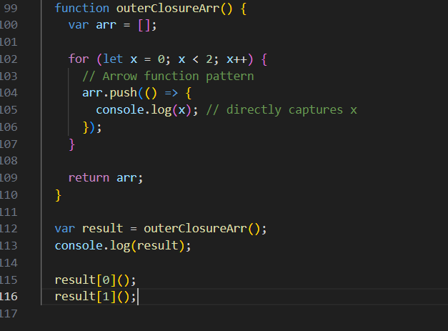
Modern JavaScript Closures: Arrow functions make closures simpler and cleaner.
Arrow functions automatically capture the this context, making them ideal for callback-heavy code,
though they do have limitations where dynamic this is needed.
const outerFunction = () => {
const outerVariable = 'Modern JavaScript Closure';
const innerFunction = () => {
console.log(outerVariable); // Accessing the outer variable
};
return innerFunction;
};
const closure = outerFunction();
closure(); // Output: 'Modern JavaScript Closure'

Slide 13
Advantages of Closures in Modern JavaScript:
Simplified Syntax with Arrow Functions: Closures are easier to write with less boilerplate code,
especially witharrow functions.
Lexical this in Arrow Functions: Arrow functions automatically bind this lexically, which prevents common
pitfalls where this can change unexpectedly in callbacks or asynchronous code.
Cleaner Code: Code readability is enhanced due to shorter and more intuitive function
declarations.
Disadvantages of Closures in Modern JavaScript:
Arrow Function Limitations: Arrow functions aren't always suitable for all situations (e.g., methods on
objects that require dynamic this binding). In such cases, regular functions are still necessary.
Memory Overhead: Just like in classic JavaScript, closures still hold references to variables
in their outer scope, which could lead to memory leaks if not properly managed in
long-running applications.

Slide 14
Advantages:
1. Closures enable data privacy and encapsulation.
2. Closures can lead to more modular and maintainable code.
Disadvantages:
1. Closures can lead to memory leaks if not handled properly.
2. Overuse of closures might impact performance.
Best Practices and Modern Usage:
1. Use arrow functions for callbacks to avoid `this` binding issues.
2. Prefer `let` and `const` over `var` to avoid closure pitfalls in loops.
3. Use closures judiciously; consider using classes or modules for complex structures.

Slide 15
Thanks

